Slide 1

Optimizing Hotel Booking Strategies
In this presentation, we’ll explore data-driven solutions to address challenges in the hospitality industry, focusing on reservation
Cancellations, pricing strategies, and targeted offers. Our goal is to
Provide practical recommendations to improve revenue management
and operational efficiency for City hotel and Resort hotel.

Slide 2
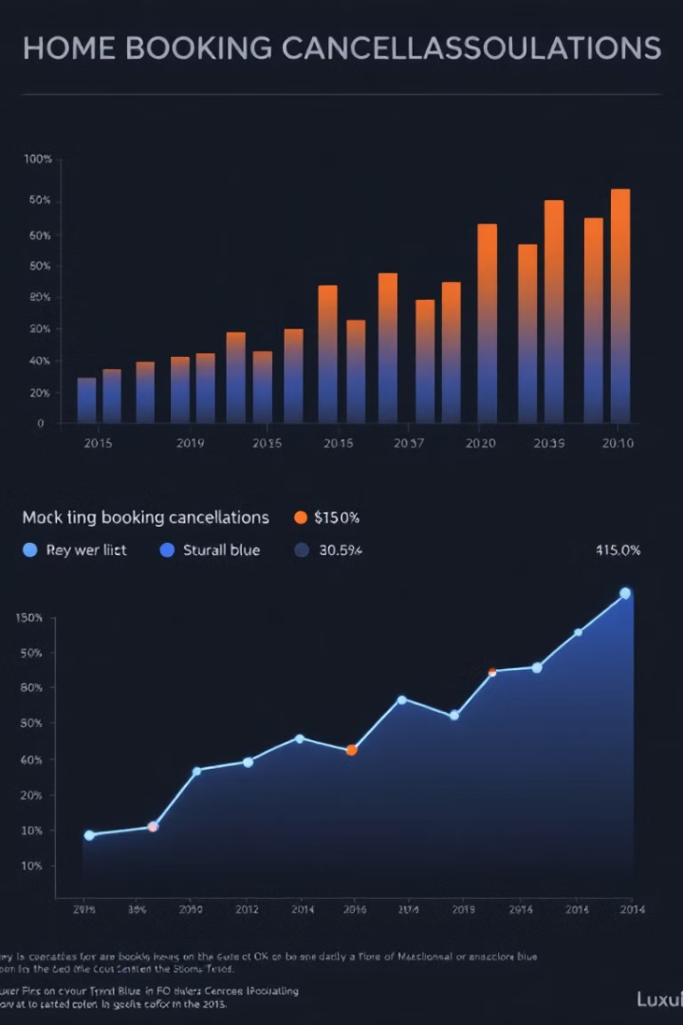
Hospitality Industry Challenges
1
Global Economic Impact
2
High Cancellation Rates
Crucial role in the global economy.
Significant impact on hotel revenue.
3
Disruption to Operations
4
Data-Driven Solutions
Operational planning and efficiency.
Analyze booking behaviors and predict cancellations.

Slide 3





City and Resort Hotel Issues
Booking Cancellations
Revenue Loss
Operational Costs
Pricing Challenges
Vacant rooms result in lost income.
Fixed costs remain despite cancellations.
Strategies fail to adapt to fluctuating demand.
Increasing cancellation rates impact revenue.

Slide 4
Framework for Analysis
Assumptions guide our analysis of hotel booking cancellations.
1
Data Reliability
Accurate booking trends from 2015 to 2017.
2
Strategy Relevance
Applicable to current hotel operations.
3
Feasibility
Practical implementation without challenges.
4
Innovation
New approaches for the hotels.
We investigate the drivers of cancellations and explore solutions.
1
Cancellation Impact
Significant revenue loss for hotels.
2
Empty Rooms
Unoccupied rooms after cancellations.
3
Booking Trends
Seasonal patterns within the same year.
These assumptions underpin our investigation into booking cancellations.
1
Guest Cancellation Reasons
Factors driving cancellations.
2
Cancellation Reduction Strategies
Minimizing cancellations.
3
Pricing and Offer Optimization
Attracting guests through pricing and promotions.
The primary goal is to minimize cancellations, maximize room occupancy, and enhance revenue.

Slide 5
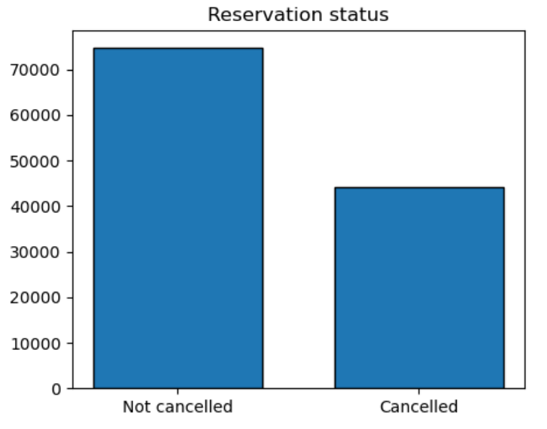
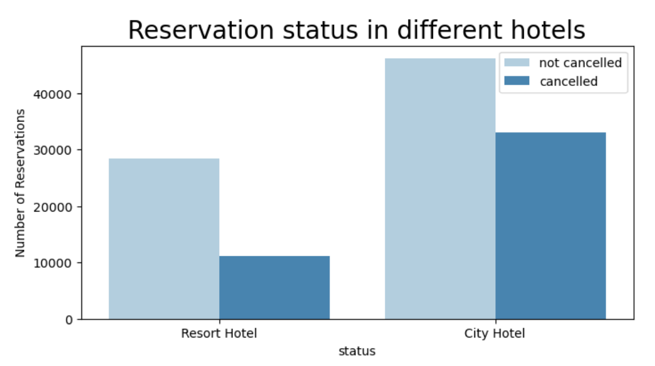
Data Visualization Insights
Overall Cancellation Rates
City vs. Resort Bookings
Industry average is 40%.
City hotels have higher booking volume.
Hotel cancellation rate is 37%.
Resort hotels have lower cancellation rates.

Slide 6
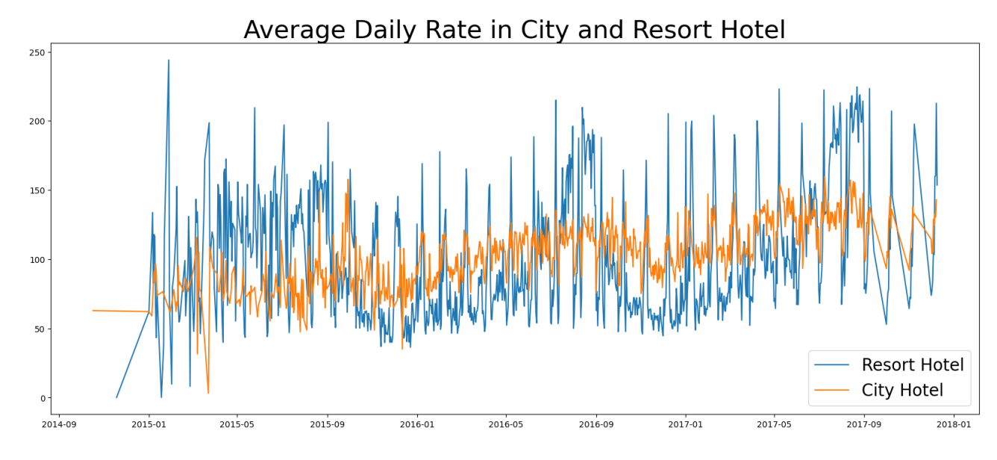
ADR Trends and Impacts
Average daily rate (ADR) fluctuations provide insights for optimization.
City and resort hotels show distinct pricing patterns.
20
$250
Percent Increase
Peak ADR
Weekend ADRs for both types.
Resort hotels during holidays.
2016
15
Stable Pricing
Percent Increase
City hotels demonstrate consistent rates.
Weekend ADRs over weekday rates.

Slide 7
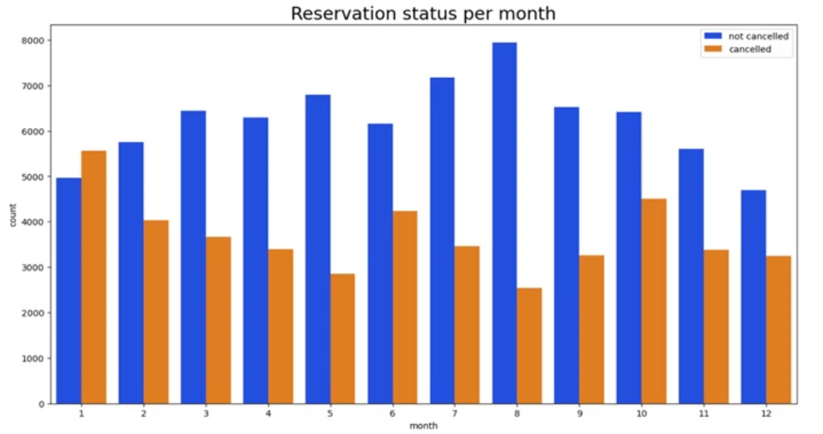
Monthly Trends and ADR Impact
Reservation Patterns
ADR Effects
August: Peak bookings (~8,000)
Higher ADR linked to more cancellations
January: Highest cancellation rate
January: Highest ADR (~$500) and cancellations
Spring/Fall: More stable demand
August: Low cancellations despite high ADR

Slide 8



ADR's Influence on Cancellations
Strategies for High-ADR Months
Discounted Packages
Higher ADR, More Cancellations
Offer special deals to reduce cancellations during high-ADR periods like January.
Price sensitivity influences guest decisions, leading to more cancellations at higher rates.
January: High ADR, High Cancellations
Flexible Payment Plans
Introduce payment options to ease financial burden and encourage booking retention.
January has the highest ADR ($500) and cancellation rate, likely due to post-holiday cost concerns.
August: Moderate-High ADR, Low Cancellations
Value Alignment
Replicate August's success by aligning pricing with guest value perception in other periods.
Despite higher prices, August has the lowest cancellation rates during peak summer travel.

Slide 9
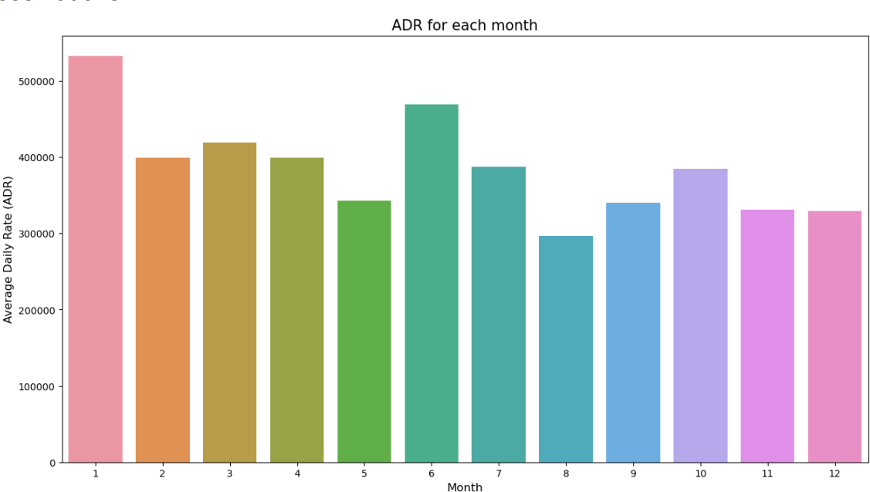



Strategic Recommendations for ADR Management
Flexible Pricing
Implement tiered pricing or early-bird discounts in high-ADR months to retain bookings.
Value-Based Offers
Pair premium pricing with added benefits, like inclusive packages or enhanced experiences.
Guest Behavior Analysis
Study seasonal patterns to refine pricing strategies for high and low-demand periods.

Slide 10
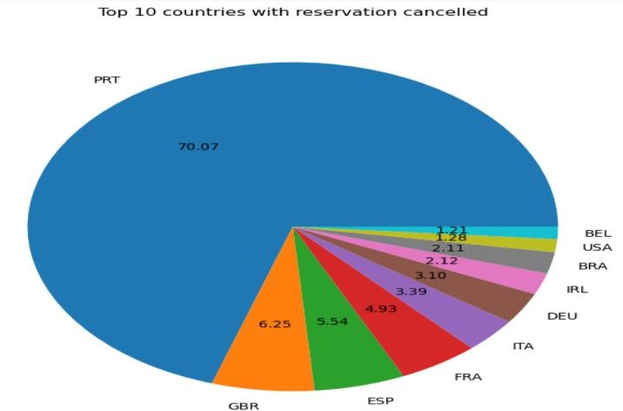
Global Cancellation Overview
70.07%
Portugal
Accounts for the majority of cancellations, making it a critical market.
6.25%
United Kingdom
Second highest contributor to cancellations, warranting attention.
5.54%
Spain
Third highest cancellation rate, significant enough for targeted strategies.

Slide 11
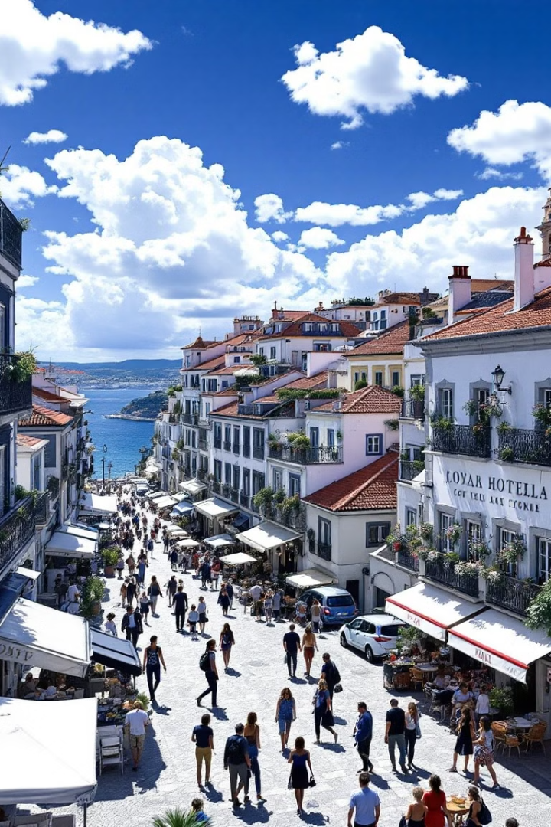
Understanding Portugal's High Cancellation Rate
Economic Uncertainty
Flexible Booking Policies
Local economic factors may contribute to higher cancellation rates.
Lenient cancellation terms might encourage more frequent booking changes.
Guest Behavior
Specific preferences or habits of Portuguese guests may influence cancellations.

Slide 12

Strategies for Key Markets
1
2
3
Portugal
UK and Spain
Global Markets
Introduce stricter cancellation policies and launch targeted loyalty programs.
Offer flexible pricing and package deals to address price sensitivity.
Analyze trends in smaller contributing countries for new opportunities.

Slide 13
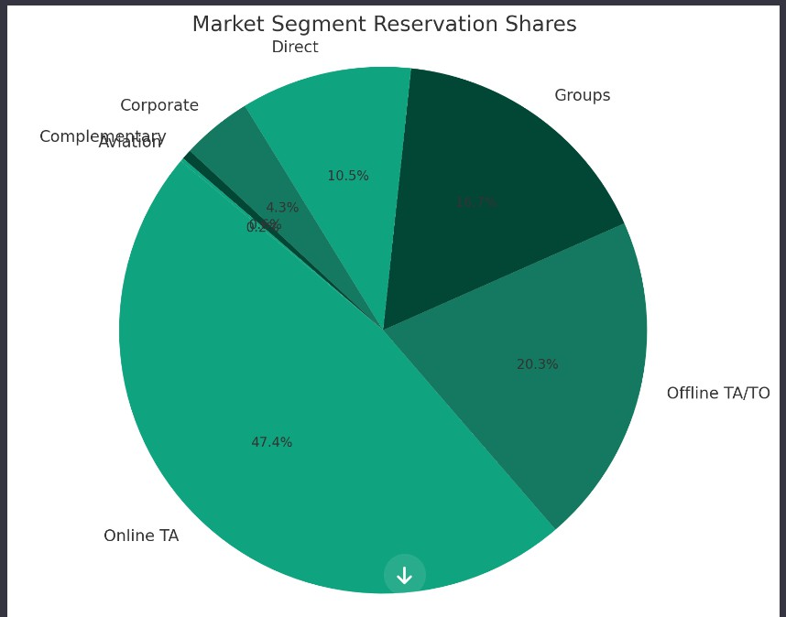



Cancellation Rates and Booking Channels
Top Cancellation Countries
Portugal: 70.07%, UK: 6.25%, Spain: 5.54%
Booking Channels
OTAs: 46%, TA/TO: 20.3%, Groups: 27%, Direct: 4%
Strategic Recommendations
Increase direct bookings, optimize OTA strategy, enhance group packages

Slide 14
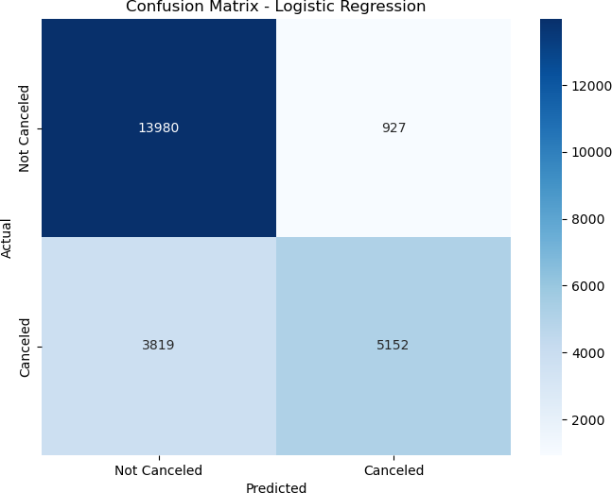
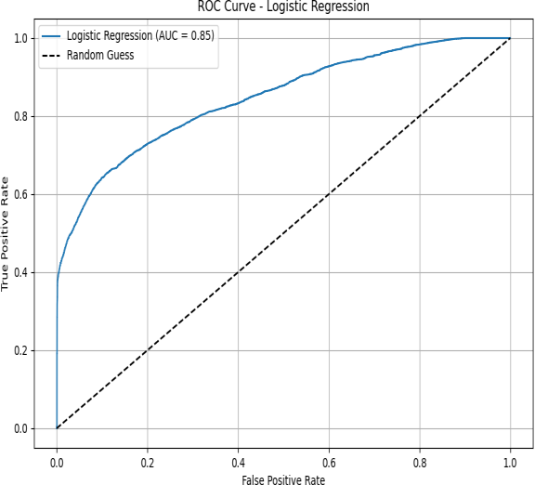
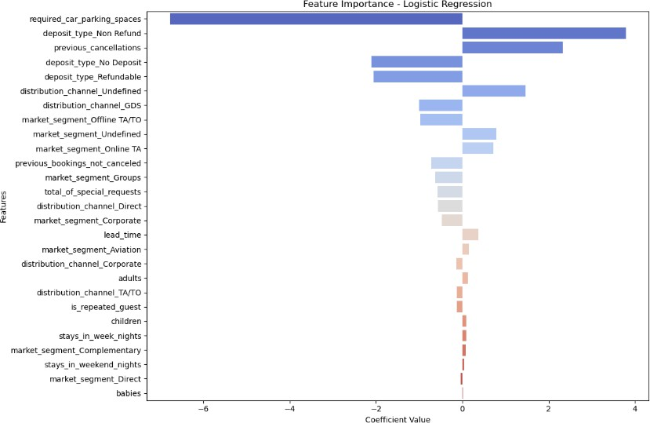
Research Question 1: Cancellation Reasons
Model Performance
Key Findings
The Logistic Regression model accurately predicted cancellations 80.1% of the time.
Longer booking lead times increase cancellation likelihood.
The model achieved an ROC AUC Score of 84.6%, indicating strong ability to distinguish between cancellations.
Non-refundable deposits reduce cancellations, while special requests demonstrate commitment.

Slide 15

Actionable Insights from Cancellation Research
Guest Behavior
Channel Analysis
Guests with long lead times or refundable deposits are more prone to cancel.
Higher cancellation rates from Online Travel Agencies suggest a need for targeted retention efforts.

Slide 16
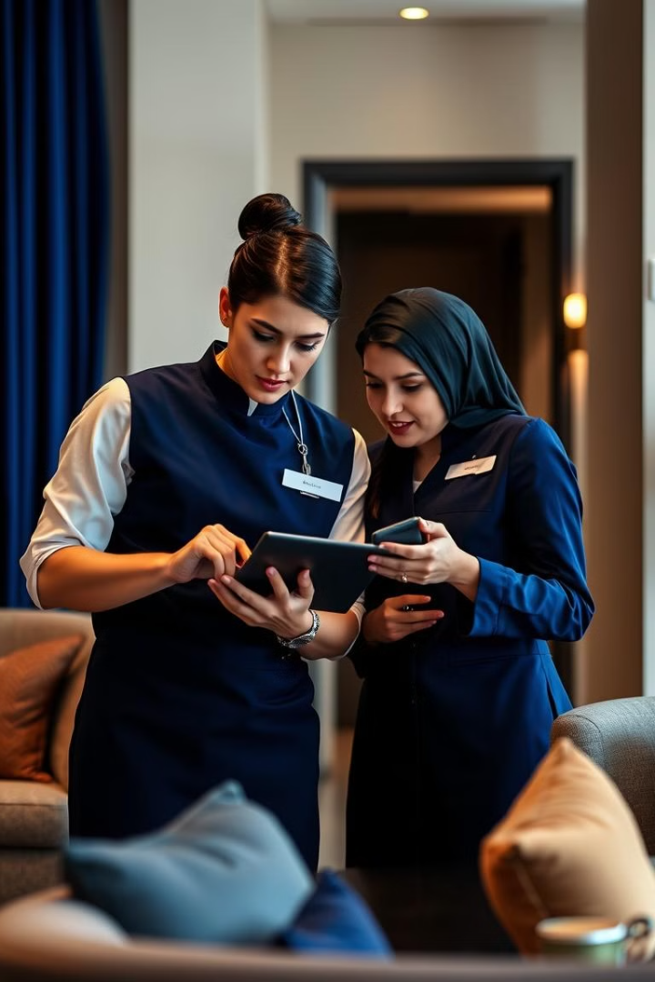
Recommendations to Reduce Cancellations
1
Flexible Booking Policies
2
Target High-Risk Guests
Offer tiered pricing options that vary by cancellation terms, balancing guest flexibility and revenue.
Focus retention campaigns on guests with long lead times or those who frequently cancel.
3
Increase Guest Commitment
Encourage guests to make special requests or choose non-refundable deposits.

Slide 17
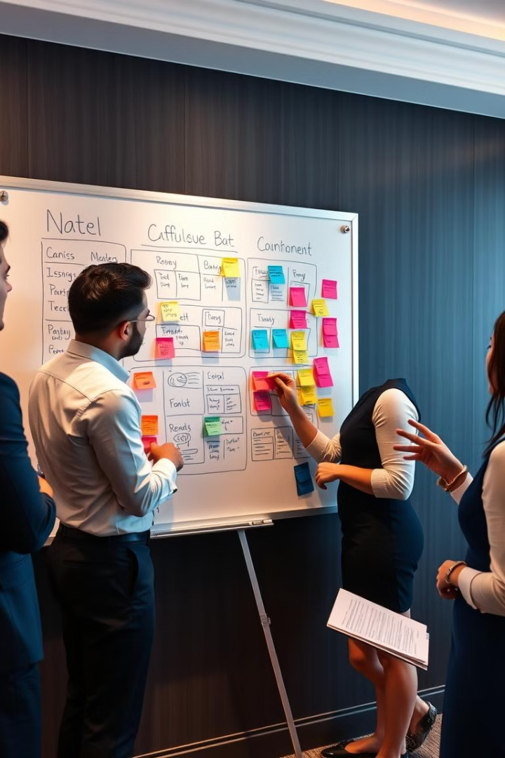
Research Question 2: Minimizing Cancellations
1
Deposit Type
Non-refundable deposits significantly reduce cancellations.
2
Special Requests
Guests with more requests are less likely to cancel, indicating a stronger commitment.
3
Market Segment
Bookings via Online Travel Agencies are more prone to cancellations.

Slide 18
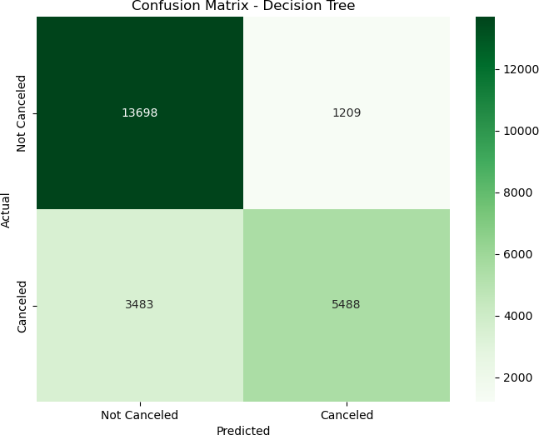
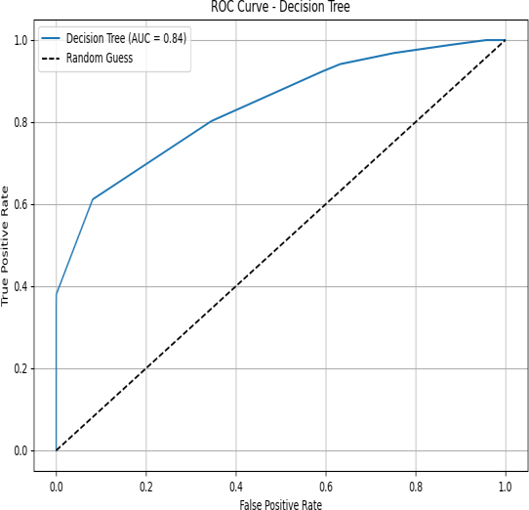
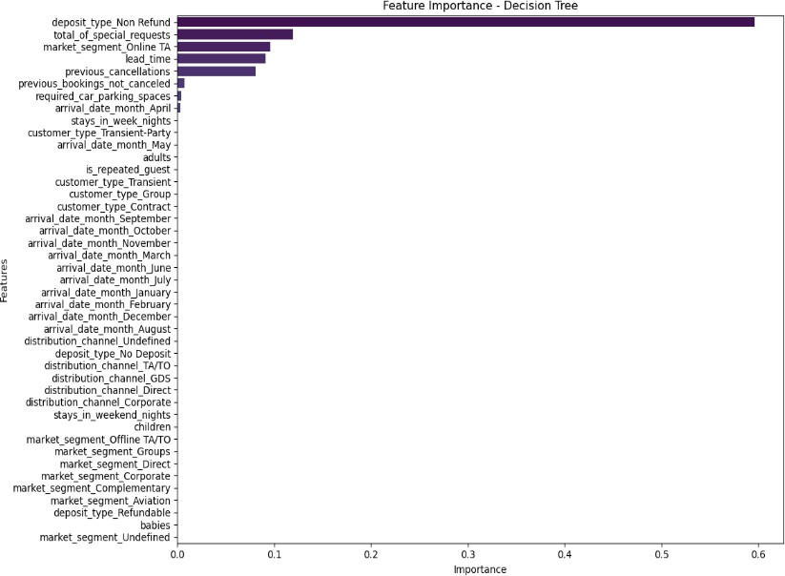
Customer Behavior Insights: Cancellation Patterns
Transient Customers
High-Risk Channels
They cancel more often compared to group bookings.
Online Travel Agencies and certain months, like January, have higher cancellation tendencies.

Slide 19

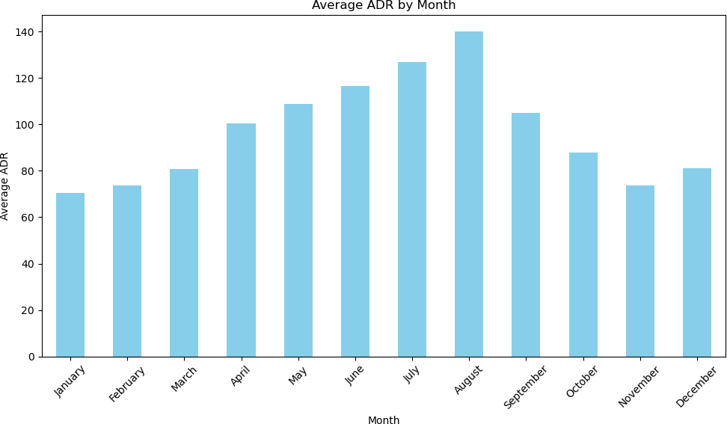
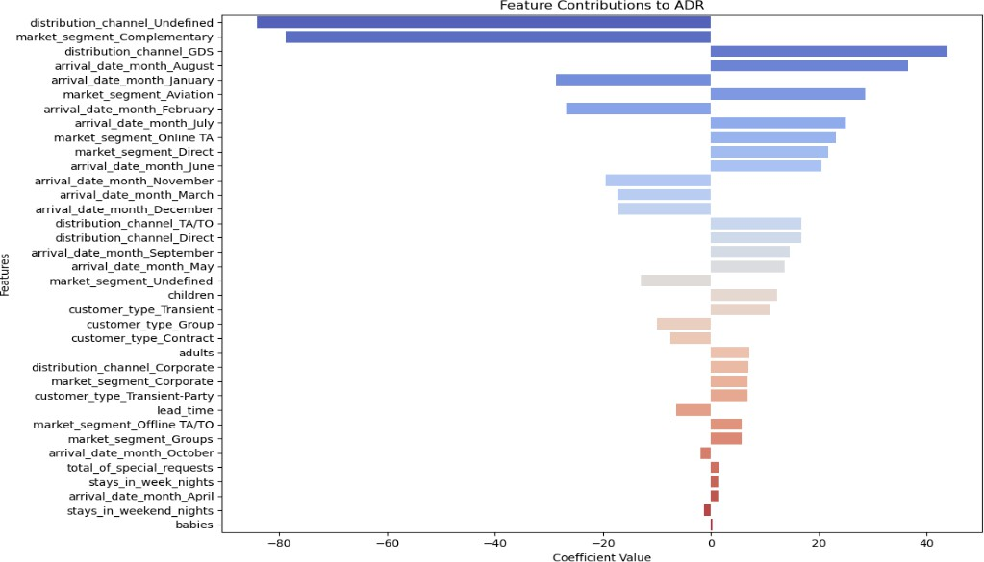
Research Question 3: Optimizing Pricing and Special Offers
Seasonality
ADRs peak during August and December due to high demand.
Lower ADRs in January and February indicate the need for targeted offers.
OTA and group bookings show lower ADRs, requiring improvement strategies.
Market Segments
Corporate and Direct bookings have the highest ADRs.

Slide 20





Actionable Strategies for Revenue Optimization
1
Dynamic Pricing
2
Specialized Packages
3
Seasonal Promotions
4
Premium Services
5
Market Optimization

Slide 21





Methodology and Model Building
Data Preparation
1
The initial stage involved data cleaning and feature engineering.
2
Model Selection
We used Logistic Regression, Decision Tree, and Multiple Linear Regression.
3
Model Training and Evaluation
Data was split into training and testing sets. We used standard metrics for evaluation.
4
Data Visualization
EDA techniques and visualizations were used to analyze patterns and model insights.
Challenges and Solutions
5
We addressed data imbalance, seasonality, and multicollinearity using various techniques.
Python, with its powerful libraries, was the primary tool for data analysis and machine learning. This comprehensive approach ensured robust and reliable models for predicting cancellations and optimizing pricing strategies. By combining exploratory data analysis with predictive models, we were able to extract actionable insights from the data.

Slide 22
Conclusions and Recommendations
1
Dynamic Pricing is Key
2
Segmentation for Success
The research indicates that dynamic pricing strategies are crucial to address high cancellation rates in off-peak months. Hotel pricing should be adjusted in real-time based on market conditions, seasonality, and demand patterns. This approach enables hotels to maintain occupancy and profitability.
Focusing on high-value booking segments like corporate and direct bookings is essential. These segments offer higher ADRs and lower cancellation rates. Hotels should prioritize customer loyalty and tailor packages to retain these valuable clients.
3
Leverage AI and Automation
4
Personalization and Upselling
Predictive models can be used to anticipate high-risk bookings. AI-driven tools can automatically adjust pricing and manage cancellations. These technologies allow hotels to streamline operations and optimize decision-making.
Personalized marketing campaigns can target high-risk segments, such as guests with long lead times, with customized incentives to minimize cancellations. Hotels can also upsell premium services to increase revenue.

